Slide 1


Number plate detection
Using python
Presented By:
114 Param Shah(CSE)
21002171210162
(C-1)

Slide 2
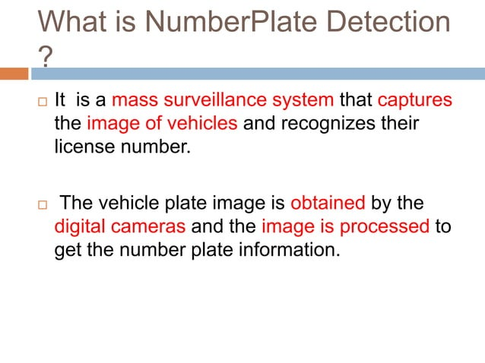

Slide 3
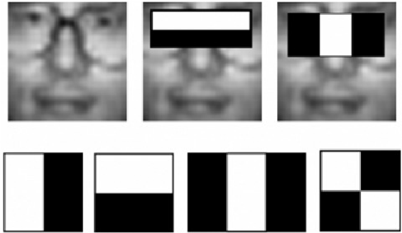
PROPOSED METHOD (HAARCASCADE Algorithm)
Cascade Trainer GUI software can be used for generation of haarcascade (.xml) file generation.

Slide 4
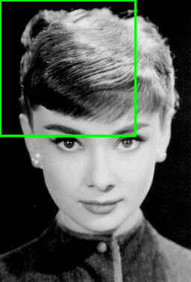
WORKING OF HAARCASCADE

Slide 5
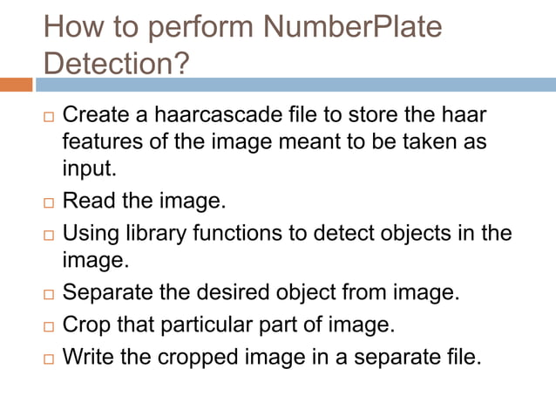

Slide 6
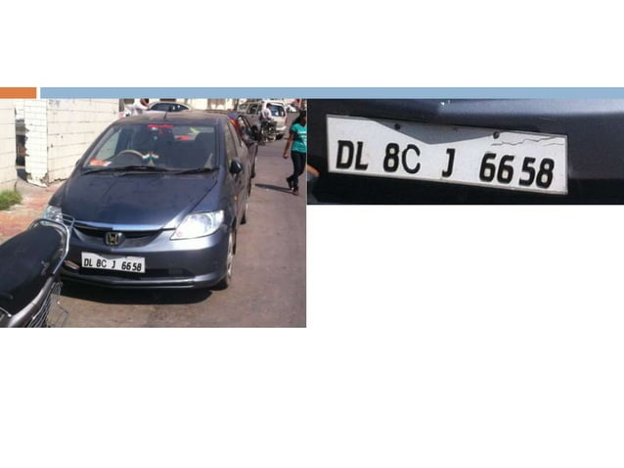

Slide 7
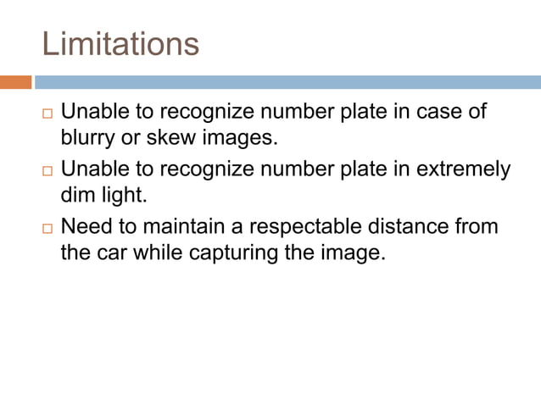

Slide 8
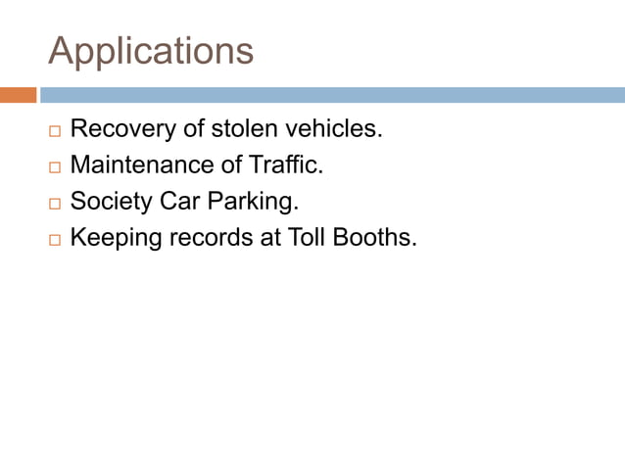

Slide 9
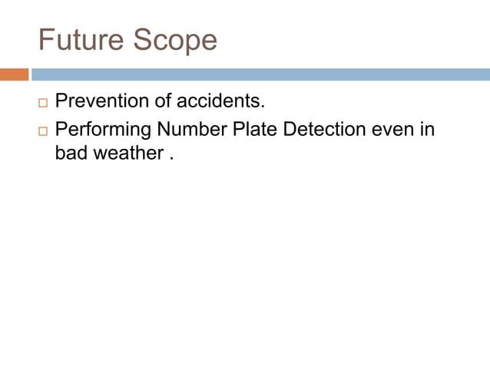

Slide 10


